Slide 1
Chapter 7: Normalization

Slide 2
Overview of Normalization

Slide 3
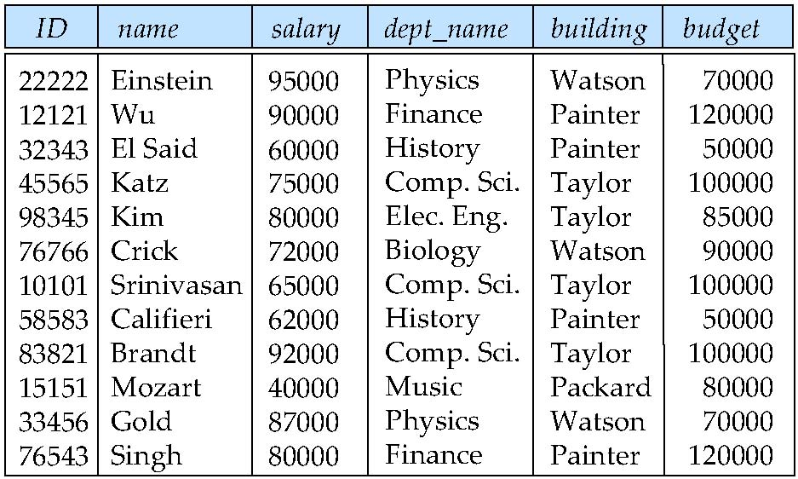
Features of Good Relational Designs
Suppose we combine instructor and department into in_dep, which represents the natural join on the relations instructor and department
There is repetition of information – REDUNDANCY
Runs the risk that budget for a specific dept. be updated for some tuples but not for the rest – INCONSISTENCY
Causes of Redundancy and Inconsistency:-
INSERTION ANOMALY - Need to use null values (if we add a new department with no instructors)
DELETION ANOMALY – Delete last employee from a dept.
UPDATION ANOMALY – Update budget for a specific dept.

Slide 4
A Combined Schema Without Repetition
Not all combined schemas result in repetition of information
Consider combining relations
sec_class(sec_id, building, room_number) and
section(course_id, sec_id, semester, year)
into one relation
section(course_id, sec_id, semester, year, building, room_number)
No repetition in this case

Slide 5
Decomposition
The only way to avoid the repetition-of-information problem in the in_dep schema is to decompose it into two schemas – instructor and department schemas.
Not all decompositions are good. Suppose we decompose
employee(ID, name, street, city, salary)
into
employee1 (ID, name)
employee2 (name, street, city, salary)
The problem arises when we have two employees with the same name
The next slide shows how we lose information -- we cannot reconstruct the original employee relation -- and so, this is a lossy decomposition.

Slide 6
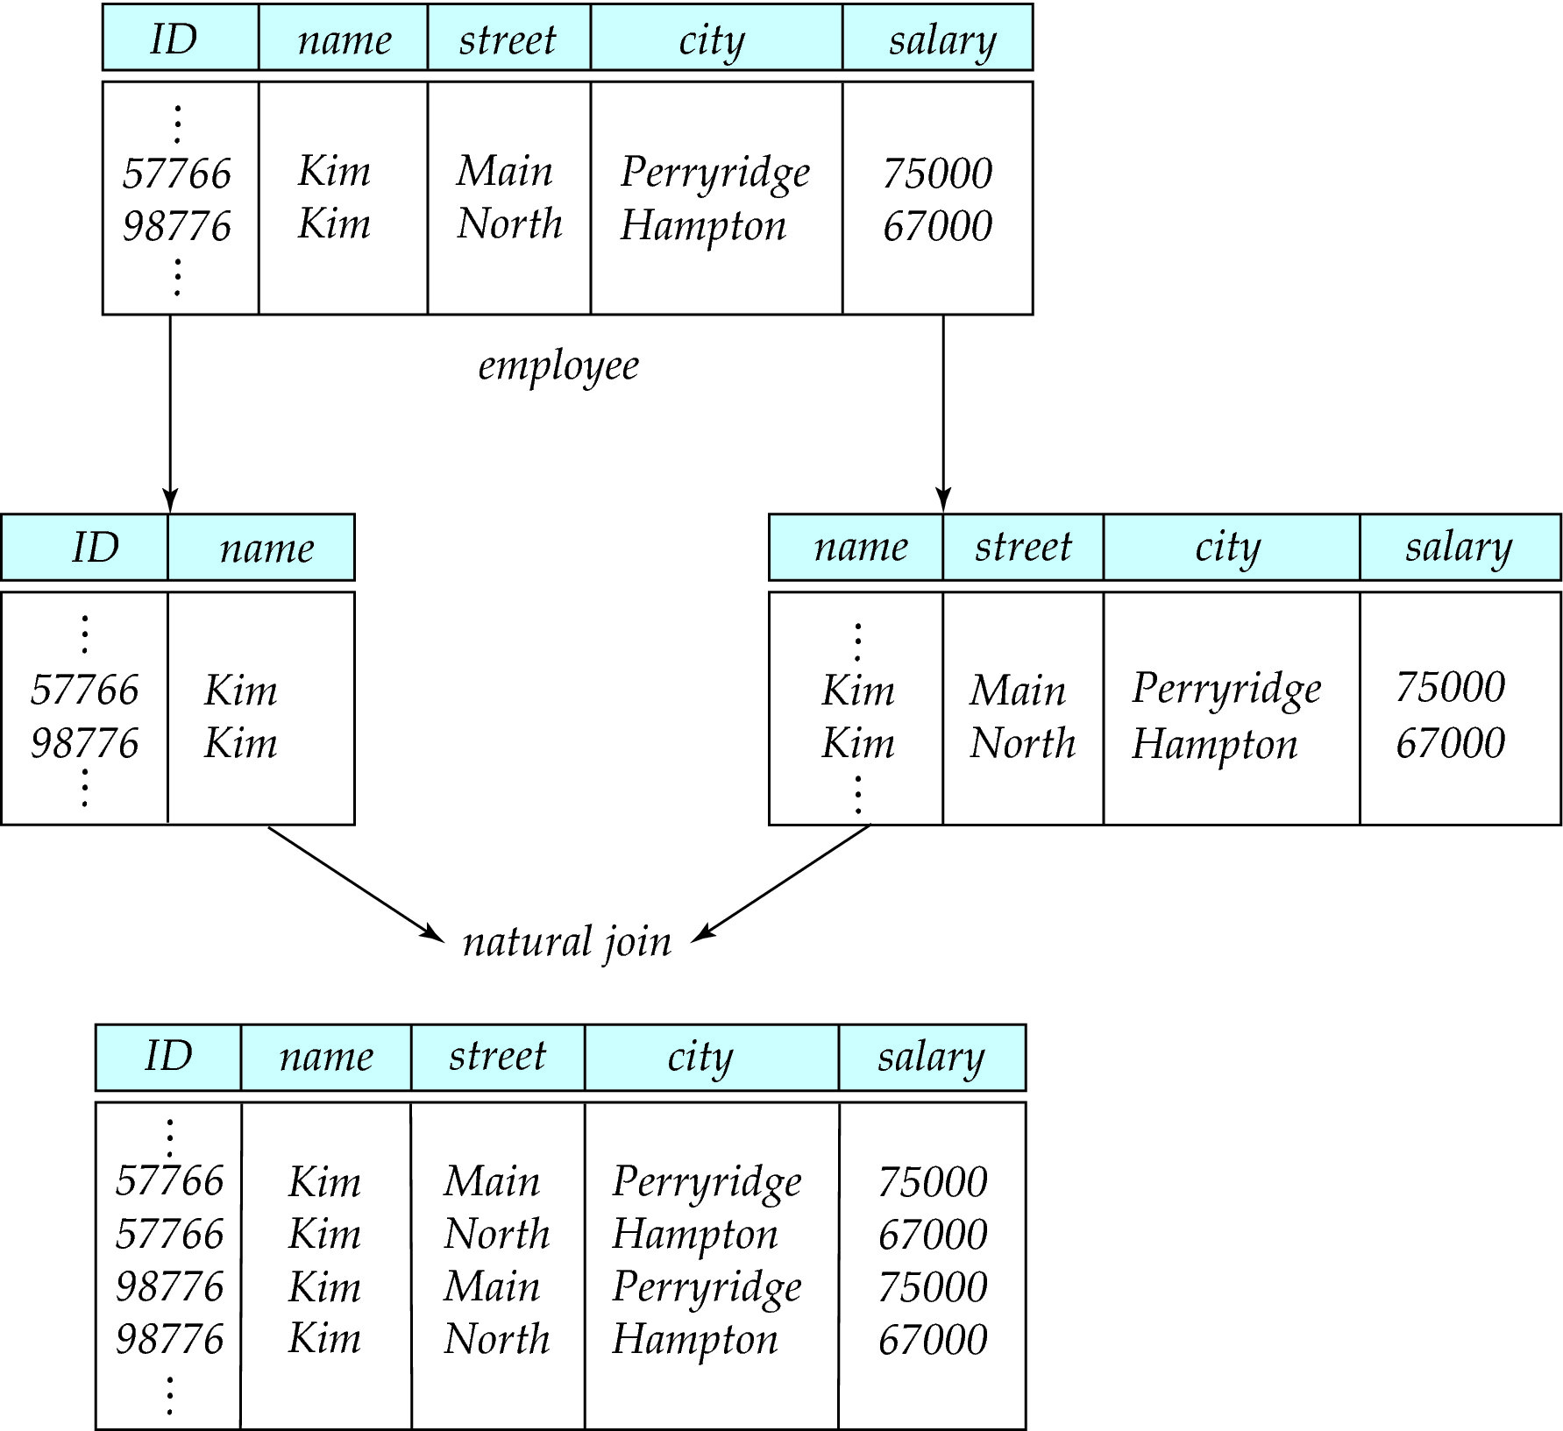
A Lossy Decomposition

Slide 7
Lossless Decomposition
Let R be a relation schema and let R₁ and R₂ form a decomposition of R . That is R = R₁ U R₂
We say that the decomposition is a lossless decomposition if there is no loss of information by replacing R with the two relation schemas R₁ U R₂
Formally,
∏ _{R1} (r) ∏ _{R2} (r) = r
And, conversely a decomposition is lossy if
r ⊂ ∏ _{R1} (r) ∏ _{R2} (r) ➔ Although #tuples increases, content of information decreases

Slide 8
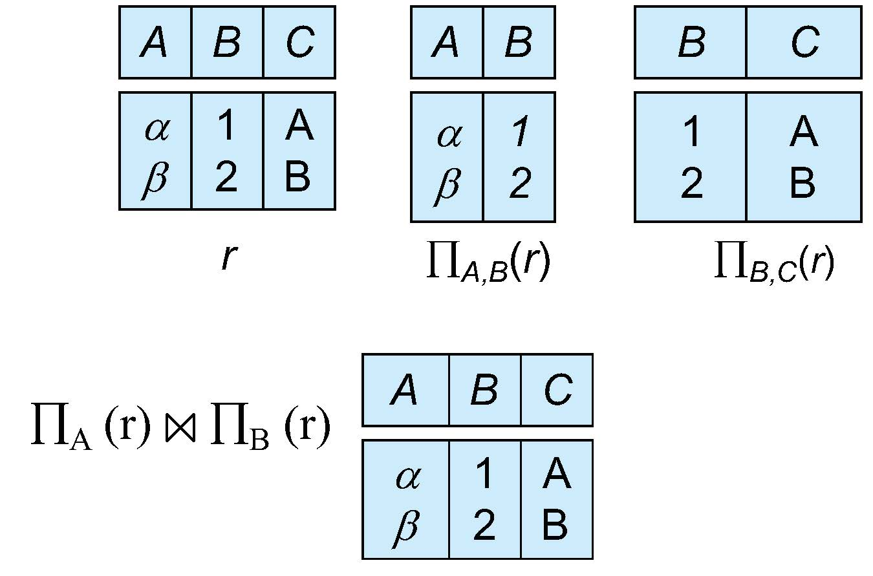
Example of Lossless Decomposition
Decomposition of R = (A, B, C) R₁ = (A, B) R₂ = (B, C)

Slide 9
Normalization Theory
Decide whether a particular relation R is in “good” form.
In the case that a relation R is “not in good” form, decompose it into set of relations {R₁, R₂, ..., R_{n}} such that
Each relation is in good form
The decomposition is a lossless decomposition
Our theory is based on:
Functional dependencies
Multivalued dependencies

Slide 10
Functional Dependencies
There are usually a variety of constraints (rules) on the data in the real world.
For example, some of the constraints that are expected to hold in a university database are:
Students and instructors are uniquely identified by their ID.
Each student and instructor has only one name.
Each instructor and student is associated with only one department.
Each department has only one value for its budget, and only one associated building.

Slide 11
Functional Dependencies (Cont.)
An instance of a relation that satisfies all such real-world constraints is called a legal instance of the relation;
(A legal instance of a database is one where all the relation instances are legal instances)
Constraints on the set of legal relations, require that the value for a certain set of attributes determines uniquely the value for another set of attributes.
A functional dependency is a generalization of the notion of a key.

Slide 12
Functional Dependencies Definition
Let R be a relation schema
α ⊆ R and β ⊆ R
The functional dependency
α → β
holds on R if and only if for any legal relations r(R), whenever any two tuples t₁ and t₂ of r agree on the attributes α, they also agree on the attributes β. That is,
t₁[α] = t₂ [α] ⇒ t₁[β ] = t₂ [β ]
Example: Consider r(A,B ) with the following instance of r.
On this instance, B → A hold; A → B does NOT hold,
4
1 5
3 7

Slide 13
Keys and Functional Dependencies
K is a superkey for relation schema R if and only if K → R
K is a candidate key for R if and only if
K → R, and
for no α ⊂ K, α → R
Functional dependencies allow us to express constraints that cannot be expressed using superkeys. Consider the schema:
in_dep (ID, name, salary, dept_name, building, budget ).
We expect these functional dependencies to hold:
dept_name→ building
ID → building
but would not expect the following to hold:
dept_name → salary

Slide 14
Use of Functional Dependencies
We use functional dependencies to:
To test relations to see if they are legal under a given set of functional dependencies.
If a relation r is legal under a set F of functional dependencies, we say that r satisfies F.
To specify constraints on the set of legal relations
We say that F holds on R if all legal relations on R satisfy the set of functional dependencies F.
Note: A specific instance of a relation schema may satisfy a functional dependency even if the functional dependency does not hold on all legal instances.
For example, a specific instance of instructor may, by chance, satisfy name → ID.

Slide 15
Trivial Functional Dependencies
A functional dependency is trivial if it is bound to be satisfied by all instances of a relation
Example:
ID, name → ID
name → name
In general, α → β is trivial if β ⊆ α

Slide 16
Closure of a Set of Functional Dependencies
It is not sufficient to consider only the given set of functional dependencies, the given functional dependencies may imply other functional dependencies
Given a set F of functional dependencies, there are certain other functional dependencies that are logically implied by F.
If A → B and B → C, then we can infer that A → C
etc.
The set of all functional dependencies logically implied by F is the closure of F.
We denote the closure of F by F⁺.

Slide 17
Closure of a Set of Functional Dependencies
We can compute F⁺, the closure of F, by repeatedly applying Armstrong’s Axioms:
Reflexive rule: if β ⊆ α, then α → β
Augmentation rule: if α → β, then γ α → γ β
Transitivity rule: if α → β, and β → γ, then α → γ
These rules are
Sound -- generate only functional dependencies that actually hold, and
Complete -- generate all functional dependencies that hold.

Slide 18
Closure of Functional Dependencies (Cont.)
Additional rules:
Union rule: If α → β holds and α → γ holds, then α → β γ holds.
Decomposition rule: If α → β γ holds, then α → β holds and α → γ holds.
Pseudotransitivity rule:If α → β holds and γ β → δ holds, then α γ → δ holds.
The above rules can be inferred from Armstrong’s axioms.

Slide 19
Example of F⁺
R = (A, B, C, G, H, I) F = { A → B A → C CG → H CG → I B → H}
Some members of F⁺
A → H
by transitivity from A → B and B → H
AG → I
by augmenting A → C with G, to get AG → CG and then transitivity with CG → I
CG → HI
by augmenting CG → I with CG to infer CG → CGI,
and augmenting of CG → H with I to infer CGI → HI,
and then transitivity

Slide 20
Procedure for Computing F⁺
To compute the closure of a set of functional dependencies F:
F ⁺ = F repeat for each functional dependency f in F⁺ apply reflexivity and augmentation rules on f add the resulting functional dependencies to F ⁺ for each pair of functional dependencies f₁and f₂ in F ⁺ if f₁ and f₂ can be combined using transitivity then add the resulting functional dependency to F ⁺ until F ⁺ does not change any further

Slide 21
Closure of Attribute Sets
Given a set of attributes α, define the closure of α under F (denoted by α⁺) as the set of attributes that are functionally determined by α under F
Algorithm to compute α⁺, the closure of α under F
result := α; while (changes to result) do for each β → γ in F do begin if β ⊆ result then result := result ∪ γ end

Slide 22
Example of Attribute Set Closure
R = (A, B, C, G, H, I)
F = {A → B A → C CG → H CG → I B → H}
(AG)⁺
1. result = AG
2. result = ABCG (A → C and A → B)
3. result = ABCGH (CG → H and CG ⊆ AGBC)
4. result = ABCGHI (CG → I and CG ⊆ AGBCH)
Is AG a candidate key?
Is AG a super key?
Does AG → R? == Is R ⊆ (AG)⁺
Is any subset of AG a superkey?
Does A → R? == Is R ⊆ (A)⁺
Does G → R? == Is R ⊆ (G)⁺
In general: check for each subset of size upto n-1

Slide 23
Uses of Attribute Closure
There are several uses of the attribute closure algorithm:
Testing for superkey:
To test if α is a superkey, we compute α^{+,} and check if α⁺ contains all attributes of R.
Testing functional dependencies
To check if a functional dependency α → β holds (or, in other words, is in F⁺), just check if β ⊆ α⁺.
That is, we compute α⁺ by using attribute closure, and then check if it contains β.
Is a simple and cheap test, and very useful
Computing closure of F
For each γ ⊆ R, we find the closure γ⁺, and for each S ⊆ γ⁺, we output a functional dependency γ → S.

Slide 24
Canonical Cover
Suppose that we have a set of functional dependencies F on a relation schema. Whenever a user performs an update on the relation, the database system must ensure that the update does not violate any functional dependencies; that is, all the functional dependencies in F are satisfied in the new database state.
If an update violates any functional dependencies in the set F, the system must roll back the update.
We can reduce the effort spent in checking for violations by testing a simplified set of functional dependencies that has the same closure as the given set.
This simplified set is termed the canonical cover
To define canonical cover we must first define extraneous attributes
An attribute of a functional dependency in F is extraneous if we can remove it without changing F ⁺

Slide 25
Extraneous Attributes
Removing an attribute from the left side of a functional dependency could make it a stronger constraint.
For example, if we have AB → C and remove B, we get the possibly stronger result A → C. It may be stronger because A → C logically implies AB → C, but AB → C does not, on its own, logically imply A → C
But, depending on what our set F of functional dependencies happens to be, we may be able to remove B from AB → C safely.
For example, suppose that
F = {AB → C, A → D, D → C}
Then we can show that F logically implies A → C, making B extraneous in AB → C.

Slide 26
Extraneous Attributes (Cont.)
Removing an attribute from the right side of a functional dependency could make it a weaker constraint.
For example, if we have AB → CD and remove C, we get the possibly weaker result AB → D. It may be weaker because using just AB → D, we can no longer infer AB → C.
But, depending on what our set F of functional dependencies happens to be, we may be able to remove C from AB → CD safely.
For example, suppose that
F = { AB → CD, A → C }
Then we can show that even after replacing AB → CD by AB → D, we can still infer AB → CD.

Slide 27
Extraneous Attributes
An attribute of a functional dependency in F is extraneous if we can remove it without changing F ⁺
Consider a set F of functional dependencies and the functional dependency α → β in F.
Remove from the left side: Attribute A is extraneous in α if
A ∈ α and
F logically implies (F – {α → β}) ∪ {(α – A) → β}.
Remove from the right side: Attribute A is extraneous in β if
A ∈ β and
The set of functional dependencies
(F – {α → β}) ∪ {α →(β – A)} logically implies F.
Note: implication in the opposite direction is trivial in each of the cases above, since a “stronger” functional dependency always implies a weaker one

Slide 28
Testing if an Attribute is Extraneous
Let R be a relation schema and let F be a set of functional dependencies that hold on R . Consider an attribute in the functional dependency α → β.
To test if attribute A ∈ α is extraneous in α
Let γ = α – {A}. Check if γ → β can be inferred from F.
Compute γ⁺ using the dependencies in F
If γ⁺ includes all attributes in β then , A is extraneous in α
To test if attribute A ∈ β is extraneous in β
Consider the set: F' = (F – {α → β}) ∪ {α →(β – A)},
check whether α⁺ in F’ contains A; if it does, A is extraneous in β

Slide 29
Examples of Extraneous Attributes
Let F = {AB → CD, A → E, E → C }
To check if C is extraneous in AB → CD, we:
Compute the attribute closure of AB under F' = {AB → D, A → E, E → C}
The closure is ABCDE, which includes CD
This implies that C is extraneous
Is D is extraneous in AB → CD? Check.

Slide 30
Canonical Cover
A canonical cover for F is a set of dependencies F_{c} such that
F logically implies all dependencies in F_{c} , and
F_{c} logically implies all dependencies in F, and
No functional dependency in F_{c} contains an extraneous attribute, and
Each left side of functional dependency in F_{c} is unique. That is, there are no two dependencies in F_{c}
α₁ → β₁ and α₂ → β₂ such that
α₁ = α₂

Slide 31
Canonical Cover
F_{c} = F
repeat
Use the union rule to replace any dependencies in F of the form
α₁ → β₁ and α₁ → β₂ with α₁ → β₁ β₂
Find a functional dependency α → β in F_{c} with an extraneous
attribute either in α or in β
/* Note: test for extraneous attributes done using F_{c,} not F*/
If an extraneous attribute is found, delete it from α → β
until (F_{c} does not change)
Note: Union rule may become applicable after some extraneous attributes have been deleted, so it has to be re-applied

Slide 32
Example: Computing a Canonical Cover
R = (A, B, C) F = {A → BC B → C A → B AB → C}
Combine A → BC and A → B into A → BC
Set is now {A → BC, B → C, AB → C}
A is extraneous in AB → C
Check if the result of deleting A from AB → C is implied by the other dependencies
Yes: in fact, B → C is already present!
Set is now {A → BC, B → C}
C is extraneous in A → BC
Check if A → C is logically implied by A → B and the other dependencies
Yes: using transitivity on A → B and B → C.
Can use attribute closure of A in more complex cases
The canonical cover is: A → B B → C

